Slide 2
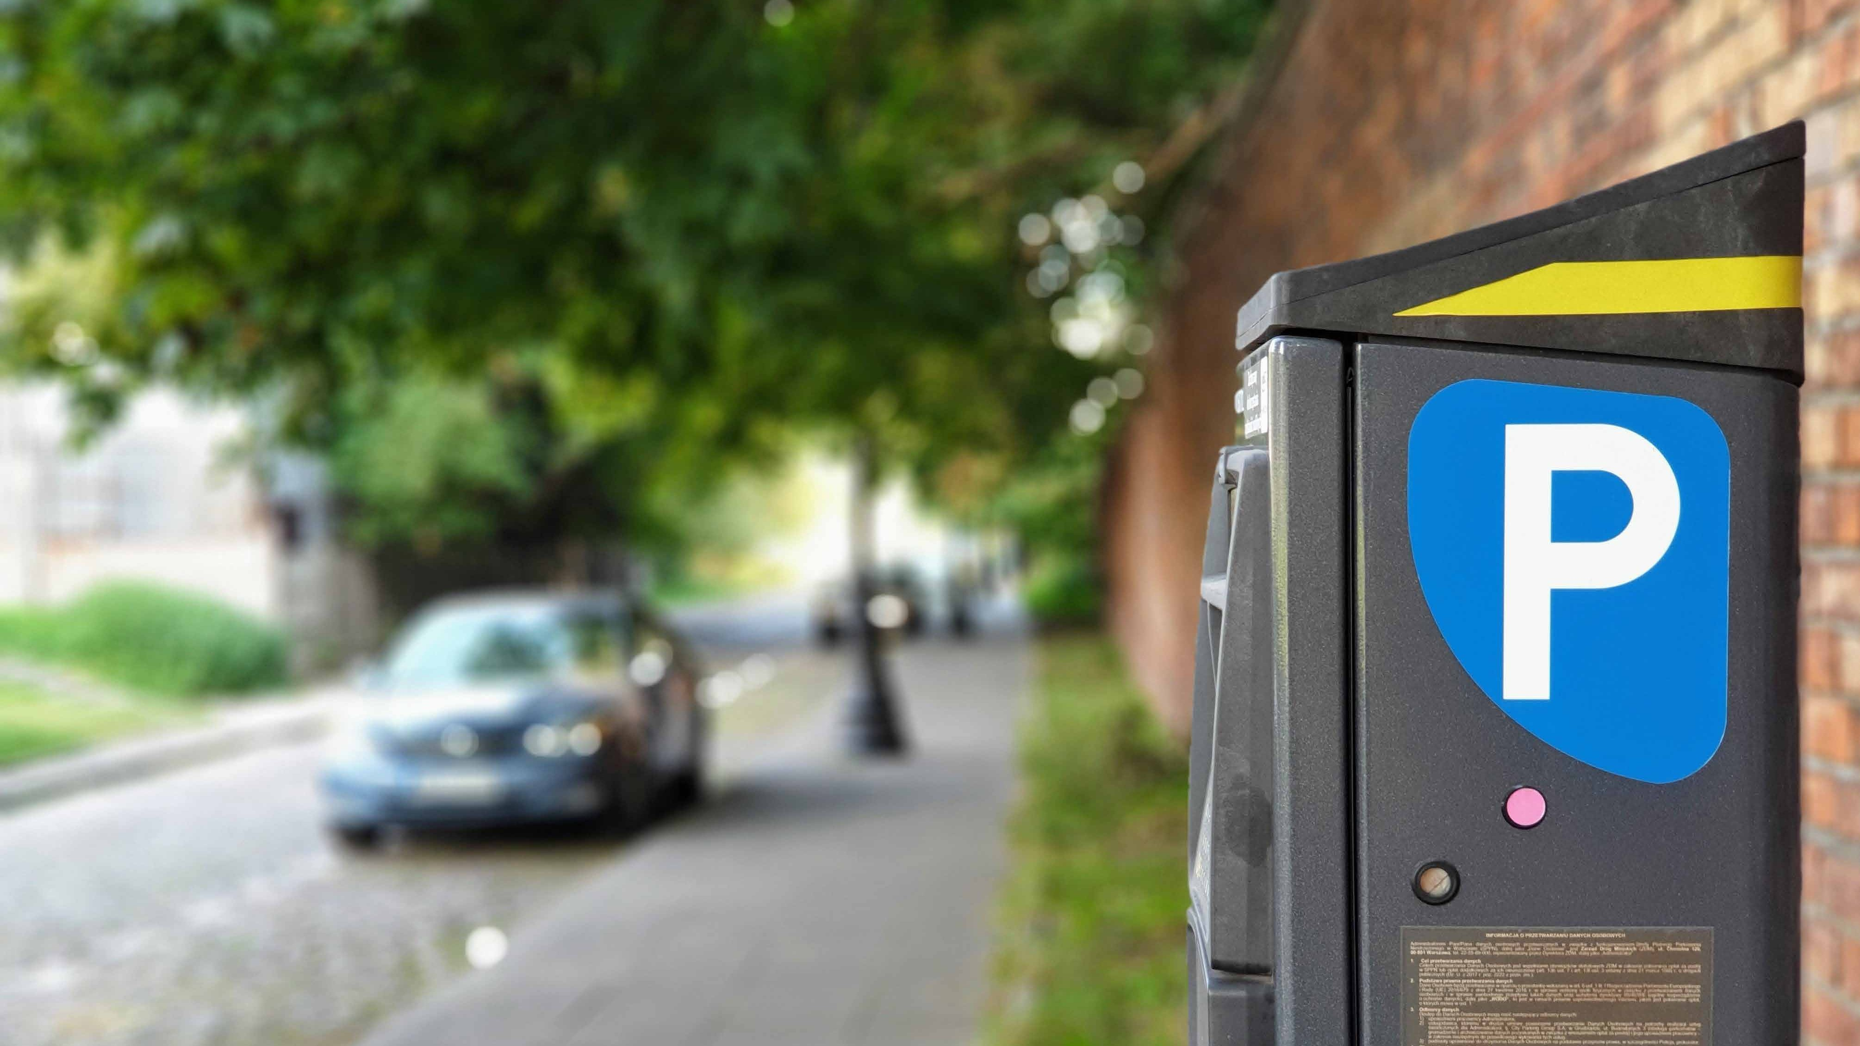













Slide 3











Slide 4






Slide 5








Slide 6



Slide 7
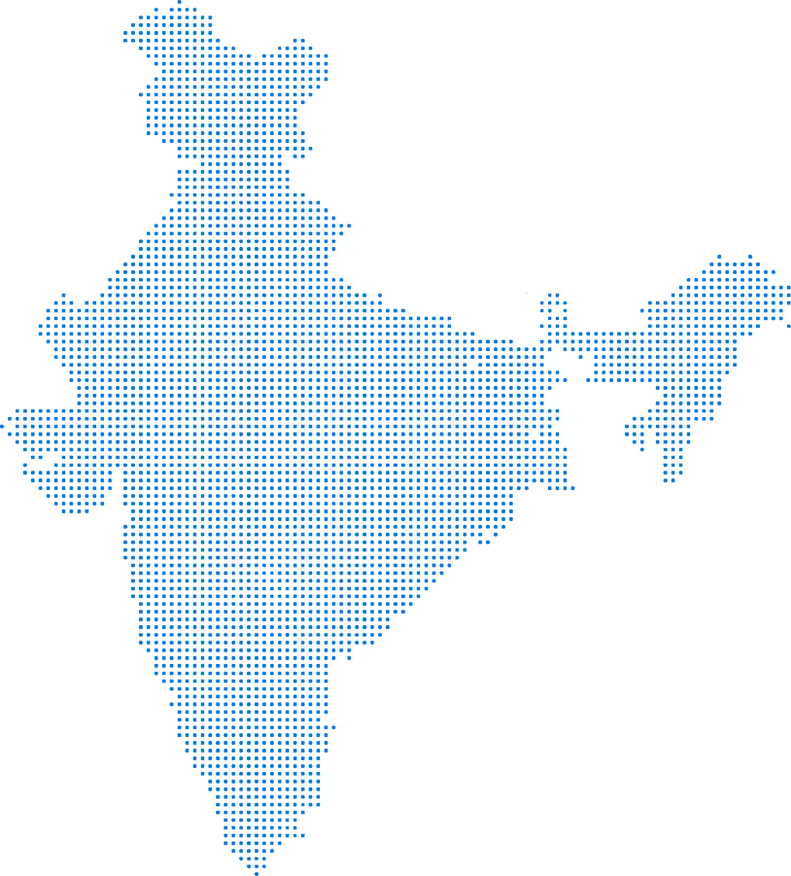
Delhi/NCR
Jaipur
Agra
Ahmedabad Indore
01
02
03
04
Mumbai
Pune
Hyderabad
Chennai
Bangalore
US
UK
India
Australia

Slide 8









Slide 9
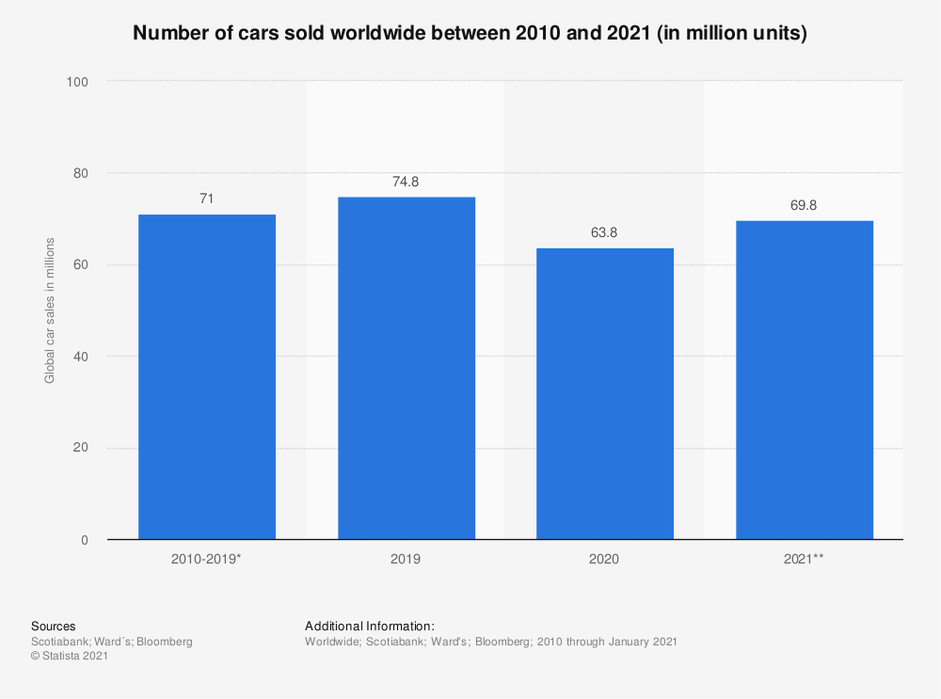
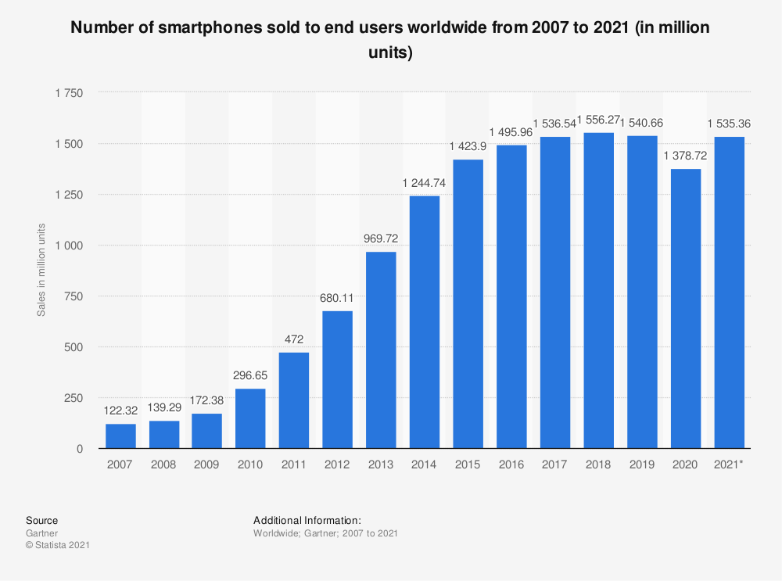

Slide 10
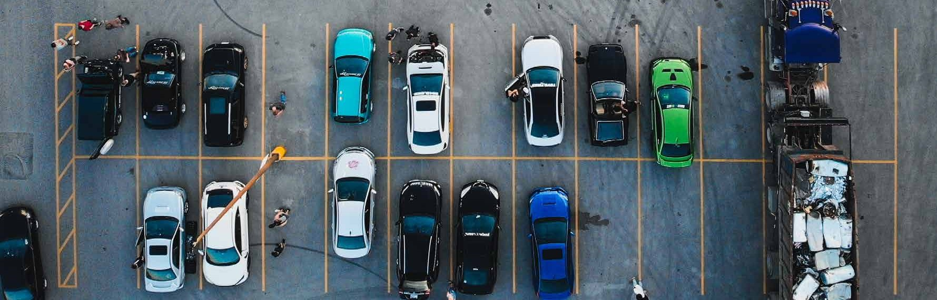

Slide 11
₹5000
140%
120%
₹4000
100%
₹3000
80%
₹2000
60%
40%
₹1000
20%
0
0
Year 1
Year 2
Year 3
Year 4
Year 5

Slide 12







Slide 13
 |  |  | ✖
 |  |  | ✖ |  | ✖ |  | ✖ |  | ✖
 |  |  | ✖ ✖ |  | ✖ ✖ |  |  |  | ✖
 |  |  | ✖ ✖ ✖ |  | ✖ ✖ ✖ |  | ✖ ✖ ✖ |  | ✖ ✖
 |  |  | ✖ ✖ ✖ |  | ✖ |  | ✖ |  | ✖
 |  |  | ✖ |  |  |  | ✖ |  | ✖
 |  |  | ✖ ✖ |  | ✖ |  | ✖ |  | ✖ ✖
 |  |  | ✖ |  | ✖ |  |  |  | ✖

Slide 14

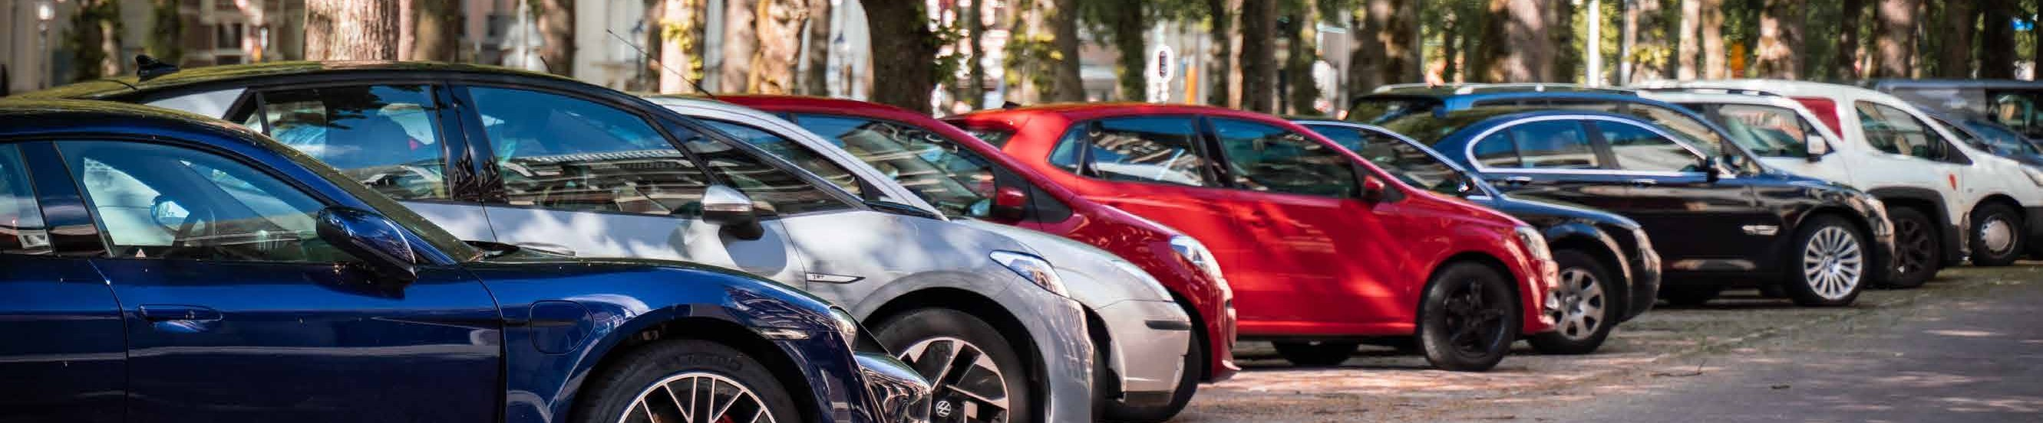
01
02
03
04

Slide 18
